Slide 1




Flood Prediction Data Analysis Source: : https://www.kaggle.com/datasets/naiyakhalid/flood-prediction -dataset Dataset: Flood Dataset Email: poojithachougani@gmail.com Phone : 9177987616 LinkedIn : www.linkedin.com/in/poojitha-chougani-554991291
Flood Data Analysis Using PySpark
Chougani Poojitha

Slide 2
Introduction
This presentation provides an analysis of the Office Employees data, covering:
- Structure and Uniqueness
- Environmental and Anthropogenic Factor Distribution
- Spatial and Scenario Representation
- Flood Probability Insights
- Climate and Land Use Patterns
- Vulnerability and Risk Hotspots
- Predictive Feature Characteristics

Slide 3
Initial Analysis of the Dataset
The flood prediction dataset contains detailed environmental and human-impact factors influencing flood risk across multiple locations and scenarios. The dataset includes variables such as MonsoonIntensity, Topography, Drainage, RiverManagement, Deforestation, Urbanization, ClimateChange, and a continuous FloodProbability score. There are no missing values, ensuring data consistency and completeness, which is an advantage for analysis. Below are the detailed insights:
1. Structure and Uniqueness
The dataset comprises thousands of rows and 21 columns. Each entry represents a unique location or scenario characterized by measured and estimated values for environmental, infrastructural, and socio-economic variables. Many feature columns include a wide spread of values, reflecting the diversity of flood risk factors. The comprehensive set of predictors ensures both inter-record uniqueness and a high-resolution description of flood-prone scenarios. This diversity allows for robust machine learning and statistical analyses.
2. Departmental Distribution
The dataset encompasses factors spanning meteorological events, land use, infrastructure, and administrative/policy effectiveness. There is significant variation in features related to Urbanization and Deforestation, and their combination with natural factors like MonsoonIntensity or Topography results in a balanced yet diverse risk landscape. This variation positions the dataset as an excellent resource for both predictive modeling and detailed environmental risk assessment.

Slide 4
Initial Analysis of the Dataset
3. State-wise Representation
Environmental factors include natural attributes like monsoon intensity, topography, drainage characteristics, river management practices, and soil types. In the dataset: Features such as MonsoonIntensity and Topography represent variations in rainfall severity and terrain, both of which influence water runoff, accumulation, and potential flooding. Drainage and RiverManagement indicate how efficiently a region’s natural and engineered systems can channel excess water.
4. Anthropogenic Factor Distribution
Anthropogenic factors are captured through features like Deforestation, Urbanization, AgriculturalPractices, Encroachments, DamsQuality, IneffectiveDisasterPreparedness, PopulationScore, and InadequatePlanning. In the dataset: Urbanization and Deforestation vary considerably, highlighting the impact of unplanned development and loss of vegetative cover, both known to increase flood susceptibility by reducing natural water absorption and increasing runoff. DrainageSystems and DamsQuality report the state of infrastructure, with low values signaling greater human-made flood risk.

Slide 5
Initial Analysis of the Dataset
5. Spatial Representation
The flood prediction dataset provides implicit spatial diversity by capturing a wide spectrum of environmental, hydrological, and land-use conditions, each corresponding to a distinct regional or local setting. Although the dataset may lack explicit geographic coordinates, its combination of features like monsoon intensity, topography, drainage, and urbanization patterns ensures that both flood-prone urban areas and less vulnerable rural landscapes are captured.
6. Scenario Representation
Each row in the flood prediction dataset represents a unique flood risk scenario constructed from the interplay of natural and anthropogenic factors. Scenarios range from high-risk cases, where multiple vulnerabilities—such as high deforestation, poor drainage, and inadequate disaster preparedness—converge, to low-risk settings characterized by robust infrastructure and effective environmental management. By sampling diverse combinations of these variables, the dataset encapsulates not just static locations, but dynamic situations that resemble evolving patterns of land use, development, and climate impacts.

Slide 6
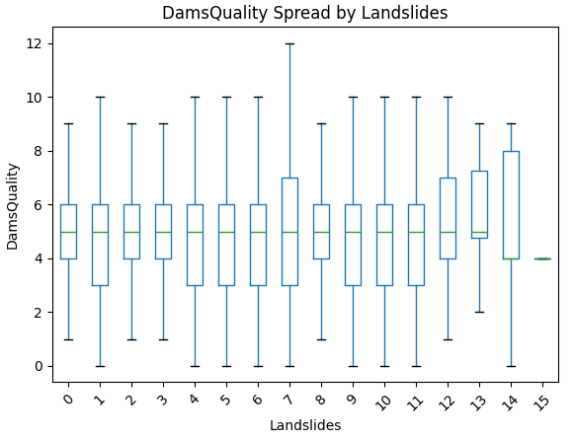
DamsQuality Spread by Landslides
This boxplot displays the spread of DamsQuality scores for each Landslides category, allowing comparison of dam conditions across different landslide frequencies. The median DamsQuality remains fairly consistent, typically around the mid-range, regardless of landslide count. Most categories show wide variability, with some extreme outliers, especially when Landslides equals 6 or 15.

Slide 7
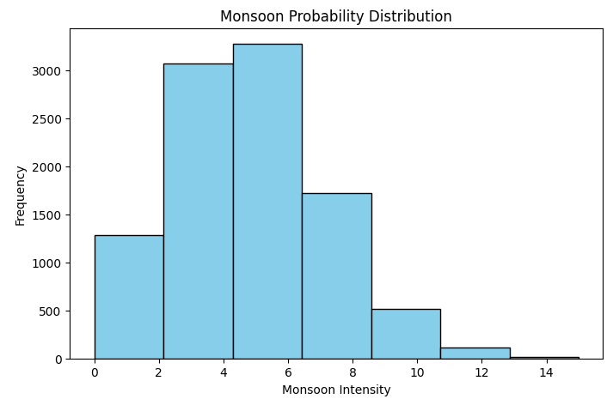
Monsoon Probability Distribution
The histogram displays the distribution of Monsoon Intensity values in the dataset, showing most records have moderate monsoon intensity between 3 and 7. The frequency drops sharply at higher intensity values, indicating that extreme monsoons are relatively rare.

Slide 8
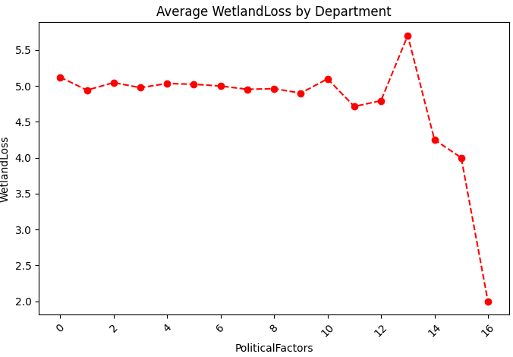
Average WetlandLoss by Department
The line plot displays the average WetlandLoss for each level of PoliticalFactors, highlighting how policy and governance may impact wetland conservation. A sharp rise and then a steep decline are observed at higher PoliticalFactors values, indicating instances where wetland loss may dramatically increase or decrease under certain political conditions.

Slide 9
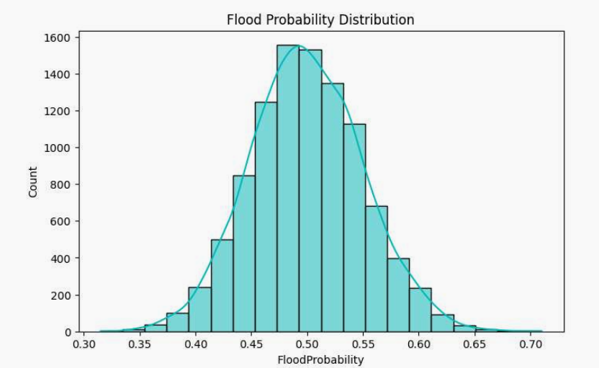
Employee Count By Department
The histogram shows flood probability is distributed nearly symmetrically, with most cases centered around a probability of 0.5. Both lower and higher probabilities are less common, resulting in a pronounced peak and tapered tails. The plot suggests flood risk in the dataset usually falls in the moderate range, with relatively few locations or scenarios at either extreme low or high risk.

Slide 10
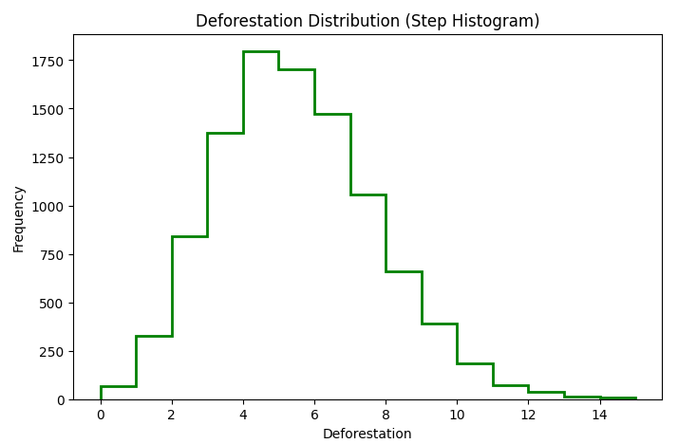
Deforestation Distribution
The histogram shows that most cases in the dataset have moderate deforestation levels, centered around values of 4 to 7. Extreme deforestation (both very low and very high) is rare, resulting in a bell-shaped distribution. Frequency drops quickly as deforestation increases beyond the mid-range.

Slide 11
Dataset Observation
Deforestation Distribution
The majority of cases have moderate deforestation values, with most scenarios falling within the 4–7 range, indicating a common but not extreme risk factor.
Very low and very high deforestation are rare, suggesting most environments are neither pristine nor severely impacted.
Flood Probability Insights
Flood probabilities are most often centered around 0.5, with extreme high and low risks much less frequent.
This distribution points to the dataset’s balance, representing a wide spectrum of typical risk scenarios rather than focusing solely on high-stress or low-risk environments.

Slide 12
Dataset Observation
Flood Probability Distribution
Flood probabilities in the dataset vary widely, with the majority of values clustering around moderate risk levels.
Most records represent typical flood risk scenarios, while some cases show significantly higher probabilities, reflecting severe vulnerability due to compounding risk factors.
Environmental and Anthropogenic Trends
Certain environmental features, such as monsoon intensity and drainage quality, consistently influence risk across scenarios, while human activities like urbanization and deforestation lead to pronounced variation.
Scenario Clustering and Diversity
Scenario representation is uneven, with some types of risk scenarios (e.g., highly urbanized, poorly managed sites) appearing more frequently as analytic clusters.

Slide 13
Conclusion
This dataset paints a picture of a diverse and multifactorial flood risk landscape shaped by both environmental and human-driven influences. Flood probabilities show structured variation, with most scenarios reflecting moderate risk but key outliers signaling severely vulnerable locations. Consistent representation of variables like monsoon intensity, drainage quality, deforestation, and urbanization ensures a balanced profile with both common and extreme risk settings. Further analysis can identify critical hotspots and explore intervention effectiveness, allowing for targeted disaster mitigation and resource allocation. The dataset is well-suited for comprehensive flood risk modeling, environmental impact studies, and planning resilient communities.

